Slide 1
Timely,Thoroughly INformative Feedback
Our goals and our achievements..
Invitation to collaborate..

Slide 2
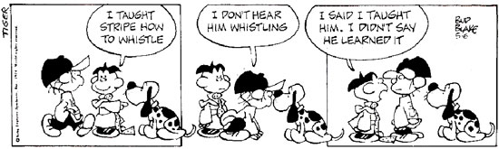

Slide 3
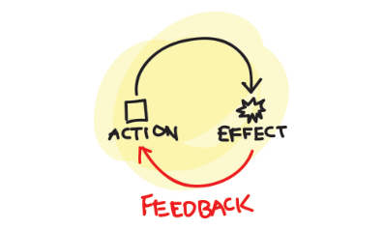
Frequent Feedback is Critical
Notes:
Assessment should mirror good instruction; happen continuously as part of instruction; and provide information about the levels of understanding that students are reaching.
In order for learners to gain insight into their learning and their understanding, frequent feedback is critical: students need to monitor their learning and actively evaluate their strategies and their current levels of understanding.
Bransford, J.D., Brown, A.L., and Cocking, R.R (2000). How People Learn: Brain, Mind, Experience, and School. Washington, DC: National Academy Press. P.78ff
http://www.nap.edu/booksearch.php?booksearch=1&term=%22students+need+to+monitor+their%22&record_id=9853

Slide 4


Feedback is especially helpful when timely & informative
Notes:
Individuals acquire a skill much more rapidly if they receive feedback about the correctness of what they have done.
One of the most important roles for assessment is the provision of timely and informative feedback to students during instruction and learning so that their practice of a skill and its subsequent acquisition will be effective and efficient.
Pellegrino, J.W., Chudowsky, N. and Glaser, R. (eds) (2001). Knowing What Students Know: The science and design of educational assessment. Washington, DC: National Academy Press.
Pellegrino, J.W., Chudowsky, N. and Glaser, R. (eds) (2001). Knowing What Students Know: The science and design of educational assessment. Washington, DC: National Academy Press. P.4 ff.
http://www.nap.edu/booksearch.php?booksearch=1&record_id=10019&term=informative%20feedback&chapter=1-16

Slide 5
WHY? What is the “effect size” of feedback
Research reports
The effect size for high-quality feedback is 1.13(std)
The effect size for Remediation / formative feedback is .65 (std)[1]
An effect-size of more than one standard deviation is the equivalent of moving from a C to an A grade.
BUT How do we strike a balance between what’s best and what’s possible?
Notes:
Research reports
The effect size for high-quality feedback is 1.13(std)
The effect size for Remediation / formative feedback is .65 (std)[1]
An effect-size of more than one standard deviation is the equivalent of moving from a C to an A grade.
BUT How do we strike a balance between what’s best and what’s possible?
[1] identification of faults followed by student’s revision(Hattie & Timperley, 2007) (Hattie, 2009)
Pellegrino, J.W., Chudowsky, N. and Glaser, R. (eds) (2001). Knowing What Students Know: The science and design of educational assessment. Washington, DC: National Academy Press. P.4 ff.
http://www.nap.edu/booksearch.php?booksearch=1&record_id=10019&term=informative%20feedback&chapter=1-16

Slide 6
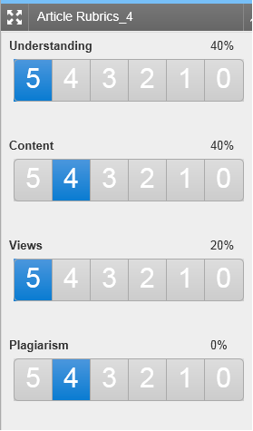
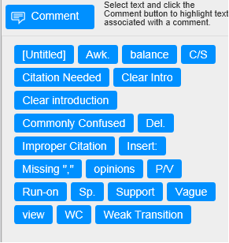
Rubric Marking with Turnitin
Figure 2.
Useful comments ‘spot on’ the document?
Figure 1.
Marking against a simple rubric is helpful??

Slide 7

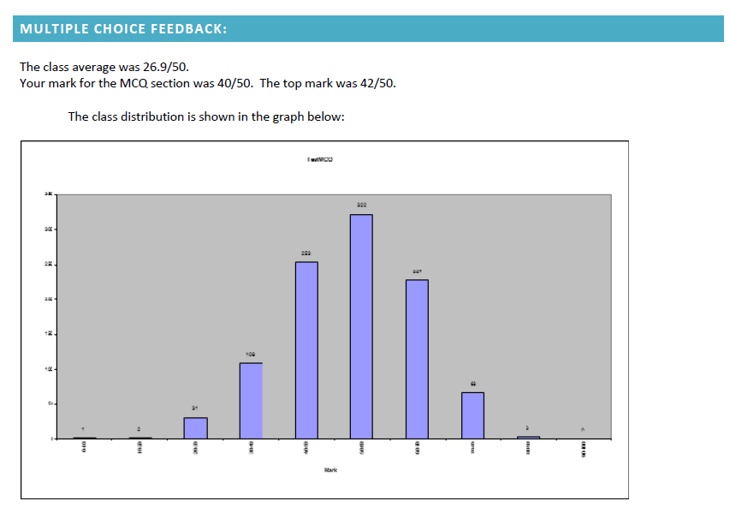
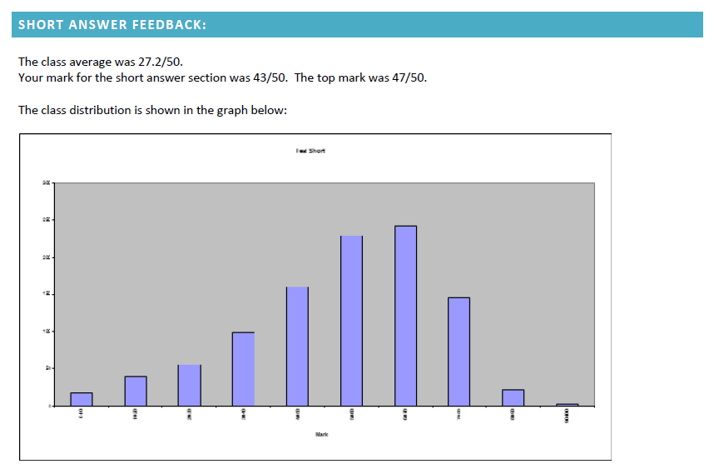
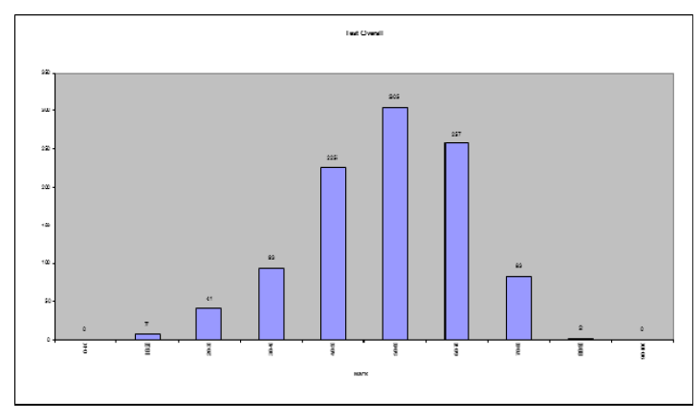
Item Analysis provided to the student with class averages

Slide 8
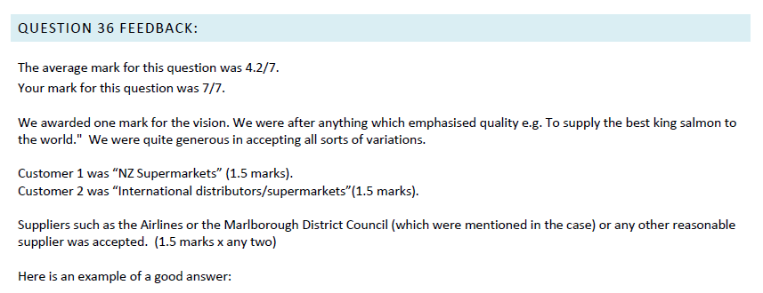
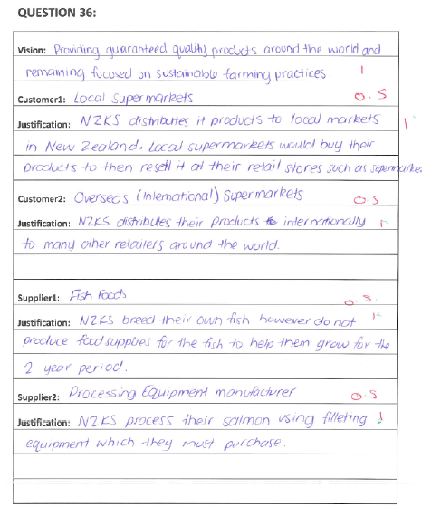
Essay questions show student mark and class average with example of good answer

Slide 9

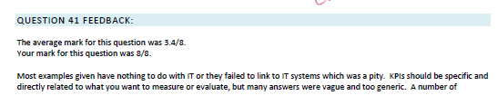
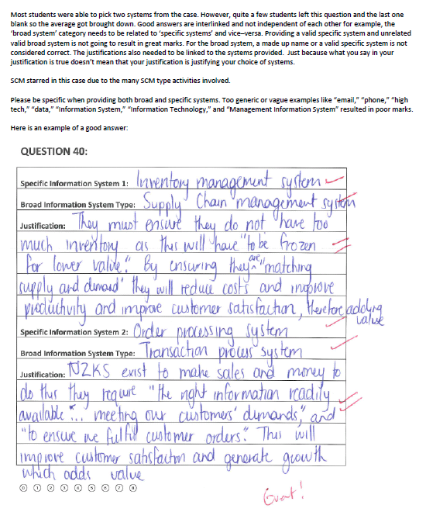
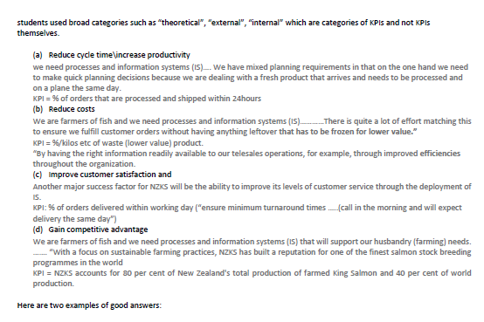
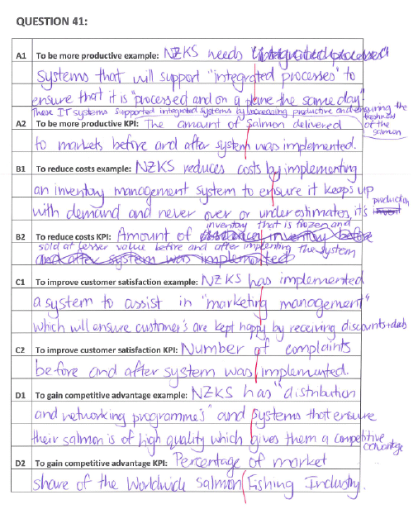
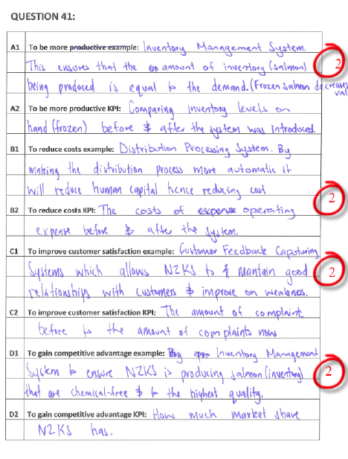
Difficult question so more feedback
Rubric
Marker
More
Examples

Slide 10
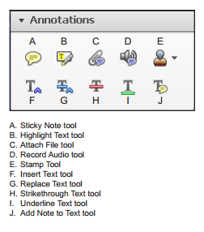
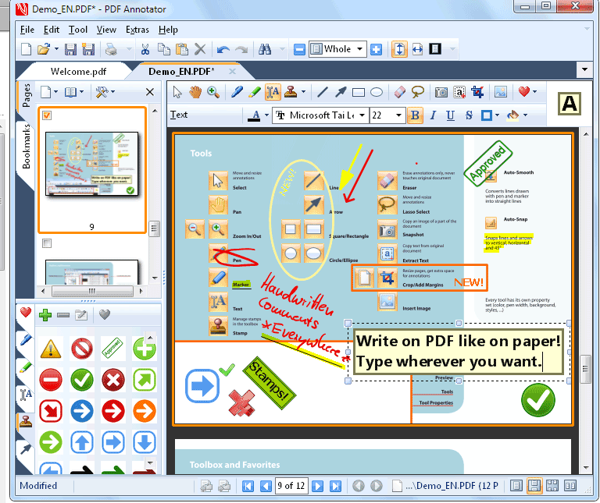
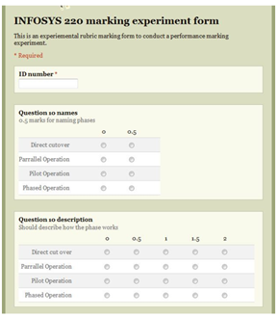

Adobe Annotator PDF Annotate Google Forms Rubric + Comments

Slide 11
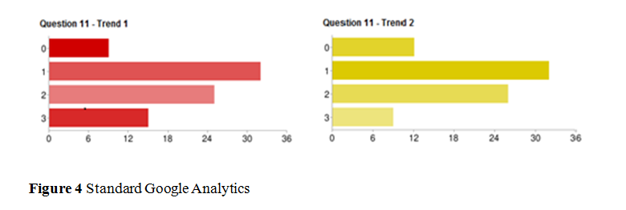
Analytics
“Out of the box” Google analytics provide a graphical representation of how a question or part of question is performing. This instant visualization can be generated at any time during the marking process.
Interpretation
Q11-Trend1: 9 students did not answer the question, 15 received full marks
Q11-Trend2: 12 students did not answer the question, 9 received full marks

Slide 12
Feedback
Rubric input
OMR input
Class Analytics

Slide 13
Lesley Gardner l.gardner@auckland.ac.nz
Don Sheridan d.sheridan@auckland.ac.nz
Thanks!

