Slide 1
Transforming Assessment Through Online Dissemination of Innovations in e-Assessment: Webinar Participation
Hillier M^{1,}& Crisp G²
¹Teaching and Education Development Institute, University of Queensland, Australia
²RMIT University, Australia
Contact Presenter: Dr Mathew Hillier m.hillier@uq.edu.au
Transforming Assessment - Past, Present and Future
The Transforming Assessment webinar series on e-assessment is now concluding its fourth year and has recently delivered the 50th session. Over this time the series has grown in popularity and recognition as a source of innovative ideas and practical examples in the field of e-Assessment in Higher Education with 2,300 direct subscribers and a further 30,000 indirect contacts. In the beginning of 2013 Transforming Assessment once again gained official support from the Office of Learning and Teaching in the form of an extension grant that will see the redevelopment of the website to include integration of Drupal, CiviCRM and Moodle as a sign-signon facility. This will allow participants to self register for webinar sessions, receive automated reminders and have access to a range of additional e-assessment resources and examples. This new facility will allow for decreased administrative overhead and improved detail and accuracy in reporting participation rates and impact of the Transforming Assessment series. In addition a mirrored set of e-assessment exemplars is under construction at the University of Queensland to localise Transforming Assessment resources in the context of institutionally supported technologies such as Blackboard, TurnITin and Adobe Connect.
Transforming Assessment is Supported by an Office for Learning and Teaching (Australian Government) Extension Grant 2013-2014
TransformingAssessment.com

Slide 2
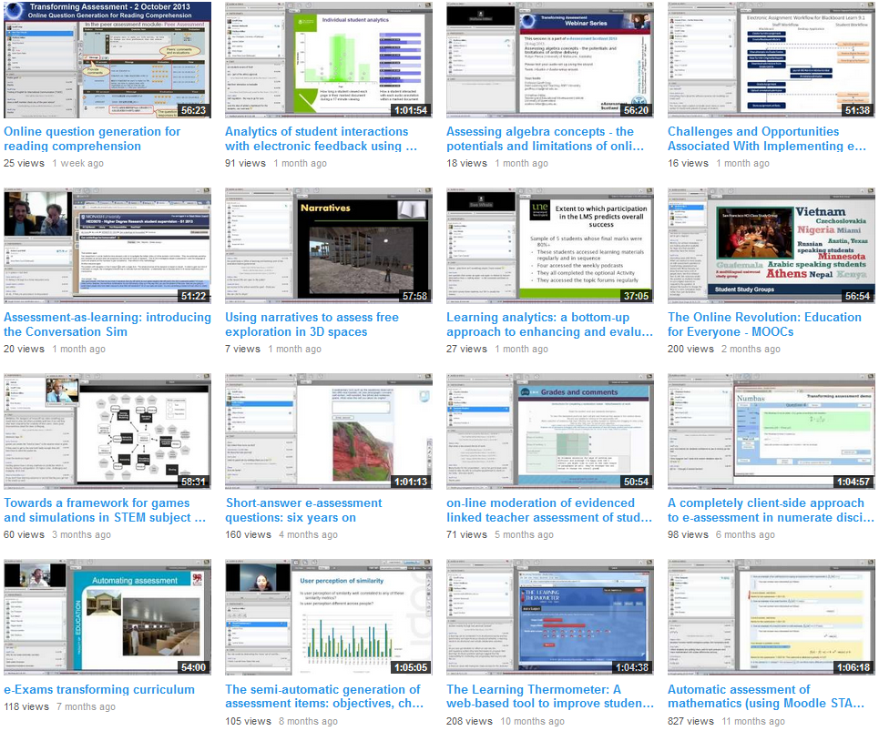
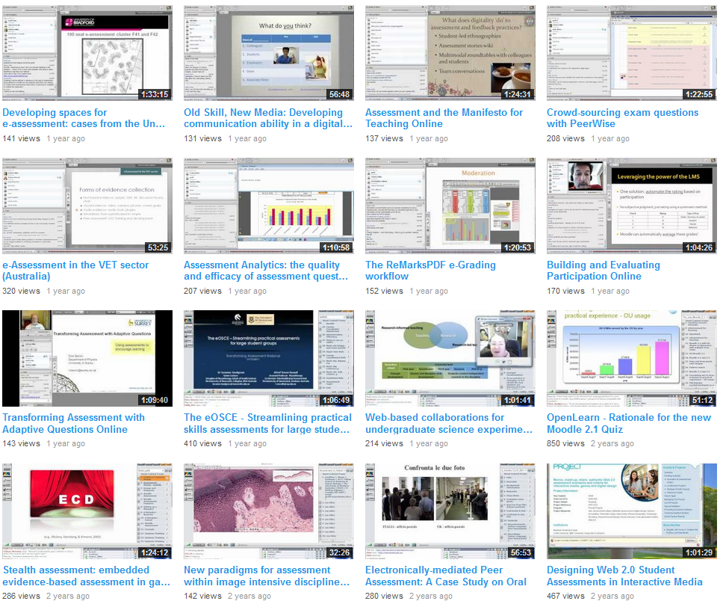
Transforming Assessment Through Online Dissemination of Innovations in e-Assessment: Webinar Participation
Hillier M^{1,}& Crisp G²
¹Teaching and Education Development Institute, University of Queensland, Australia
²RMIT University, Australia
Contact Presenter: Dr Mathew Hillier m.hillier@uq.edu.au
50+ Videos Showcasing Innovations in e-Assessment
Transforming Assessment is Supported by an Office for Learning and Teaching (Australian Government) Extension Grant 2013-2014
TransformingAssessment.com

Slide 3
Transforming Assessment Through Online Dissemination of Innovations in e-Assessment: Webinar Participation
Hillier M^{1,}& Crisp G²
¹Teaching and Education Development Institute, University of Queensland, Australia
²RMIT University, Australia
Contact Presenter: Dr Mathew Hillier m.hillier@uq.edu.au
Transforming Assessment Session Participation
Average live session attendance 24 & total 979
Transforming Assessment is Supported by an Office for Learning and Teaching (Australian Government) Extension Grant 2013-2014
TransformingAssessment.com

Slide 4
Transforming Assessment Through Online Dissemination of Innovations in e-Assessment: Webinar Participation
Hillier M^{1,}& Crisp G²
¹Teaching and Education Development Institute, University of Queensland, Australia
²RMIT University, Australia
Contact Presenter: Dr Mathew Hillier m.hillier@uq.edu.au
Conversion (RSVP to Attendance) per session
Average Conversion 64%
Transforming Assessment is Supported by an Office for Learning and Teaching (Australian Government) Extension Grant 2013-2014
TransformingAssessment.com

Slide 5
Transforming Assessment Through Online Dissemination of Innovations in e-Assessment: Webinar Participation
Hillier M^{1,}& Crisp G²
¹Teaching and Education Development Institute, University of Queensland, Australia
²RMIT University, Australia
Contact Presenter: Dr Mathew Hillier m.hillier@uq.edu.au
Repeat Participation Exactly this number of times (RSVPs)
Total RSVPs 1762
Transforming Assessment is Supported by an Office for Learning and Teaching (Australian Government) Extension Grant 2013-2014
TransformingAssessment.com

Slide 6
Transforming Assessment Through Online Dissemination of Innovations in e-Assessment: Webinar Participation
Hillier M^{1,}& Crisp G²
¹Teaching and Education Development Institute, University of Queensland, Australia
²RMIT University, Australia
Contact Presenter: Dr Mathew Hillier m.hillier@uq.edu.au
YouTube Channel Views (First Month)
Average per recording 55, Total Channel Views: 83,420
http://www.youtube.com/user/transformassessment/
Transforming Assessment is Supported by an Office for Learning and Teaching (Australian Government) Extension Grant 2013-2014
TransformingAssessment.com

Slide 7
Transforming Assessment Through Online Dissemination of Innovations in e-Assessment: Webinar Participation
Hillier M^{1,}& Crisp G²
¹Teaching and Education Development Institute, University of Queensland, Australia
²RMIT University, Australia
Contact Presenter: Dr Mathew Hillier m.hillier@uq.edu.au
Social Media Channel Membership
Subscribers: 2,300+
Indirect Audience Contacts 30,000+
Transforming Assessment is Supported by an Office for Learning and Teaching (Australian Government) Extension Grant 2013-2014
TransformingAssessment.com

Slide 8
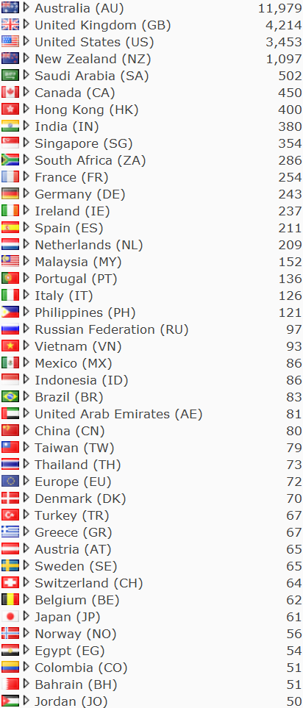
Transforming Assessment Through Online Dissemination of Innovations in e-Assessment: Webinar Participation
Hillier M^{1,}& Crisp G²
¹Teaching and Education Development Institute, University of Queensland, Australia
²RMIT University, Australia
Contact Presenter: Dr Mathew Hillier m.hillier@uq.edu.au
List Members & Website Visitors by Country
Transforming Assessment is Supported by an Office for Learning and Teaching (Australian Government) Extension Grant 2013-2014
TransformingAssessment.com

Slide 9
Transforming Assessment Through Online Dissemination of Innovations in e-Assessment: Webinar Participation
Hillier M^{1,}& Crisp G²
¹Teaching and Education Development Institute, University of Queensland, Australia
²RMIT University, Australia
Contact Presenter: Dr Mathew Hillier m.hillier@uq.edu.au
Direct List Membership by Institution (active email)
Transforming Assessment is Supported by an Office for Learning and Teaching (Australian Government) Extension Grant 2013-2014
TransformingAssessment.com

