Slide 1

Learning through Generating
Open Educational Resources
Mais M. Fatayer, MSc, PhD Candidate
School of Computing, Engineering and Mathematics
University of Western Sydney

Slide 2


















What are Open Educational Resources?
creative
commons
Atkins, D.E., Brown, J.S., & Hammond, A.L. (2007). A review of the open educational resources (OER) movement: Achievements, challenges, and new opportunities. Report to The William and Flora Hewlett Foundation.
Notes:
Any presentation about OER should start with a definition of what are OERs, they are the Digitized educational resources that are shared in public domain or have been released under an intellectual property license that permits their free use or repurposing by students, academics and life-long learners.
Open educational resources can be text files of lecture notes, course outline, past exams...OER can be video files such as lecture recording, or experiments, and can be image files such as medical images, interior design sketches, screen shots...
Under IP licenses OER can be used reused and repurposed in different contexts.
These are all shared openly without cost - means free, but that doesn’t indicates cheap!
Creative Commons is an international non-profit organisation that provides free licences and tools that copyright owners can use to allow others to share, reuse and remix their material, legally.

Slide 3




Open Educational Resources
UNIVERSITY
OF SOUTHERN
QUEENSLAND
The WILLIAM AND FLORA
HEWLETT
FOUNDATION
The Open
University
JHSPHOPENCOURSEWARE
Johns Hopkins Bloomberg School of Public Health
MITOPENCOURSEWARE

Slide 4
Learning through generating OER
Student-Constructed Open Educational Resources
Constructivism
Learning-by-Teaching
(Applefield, Huber, & Moallem, 2001,
Grzega, Joachim, & Schöner, Marion. (2008))
Notes:
Applefield, James M, Huber, Richard, & Moallem, Mahnaz. (2001). Constructivism in theory and practice: Toward a better understanding. High School Journal, 84(2), 35-53.
Grzega, Joachim, & Schöner, Marion. (2008). The didactic model LdL (Lernen durch Lehren) as a way of preparing students for communication in a knowledge society. Journal of Education for Teaching, 34(3), 167-175.

Slide 5

OER Research Gaps
  Expertise: Finding new learning resources developers (Wiley,D., 2007).
  Quality: Quality of OER that is based
  on learning design (Hodgkinson-Wiliams, C., 2010;
  Hylén, J., 2006; Bates, T., 2011a,b).
  Reusability: Reusability of learning
  resources of different forms
  (Kozinska, K. et al., 2010; Wiley,D., 2007).
  Participation: Lack of effective
  examples of quality students’
  generated content (Bull, G., 2008; Sener, J., 2007).
Thus, the goal is to find a sustainable OER model for higher educational Institutions that addresses these areas.
Notes:
Wiley, D. (2007). ON THE SUSTAINABILITY OF OPEN EDUCATIONAL RESOURCE INITIATIVES IN HIGHER EDUCATION © OECD 2007. http://www.oecd.org/dataoecd/33/9/38645447.pdf
Hodgkinson-Wiliams, C. (2010). Benefits and Challenges of OER for Higher Education Institutions: Centre for Educational Technology, University of Cape Town.
Hylén, J. (2006). Open educational resources: Opportunities and challenges. Proceedings of Open Education, 49-63.
Bates, T. (2011a). OERs: the good, the bad and the ugly. Retrieved from http://www.tonybates.ca/2011/02/06/oers-the-good-the-bad-and-the-ugly/
Bates, T. (2011b). A reflection on the OER debate: Every Which Way but Loose. Retrieved from http://www.tonybates.ca/2011/03/18/a-reflection-on-the-oer-debate-every-which-way-but-loose/
Kozinska, K., Kursun, E., Wilson, T., McAndrew, P., Scanlon, E., & Jones, A. (2010). Are open educational resources the future of e-learning?
Bull, G. (2008). Capitalizing otn the cognitive surplus. Learning and leading with technology, 10-11.
Sener, J. (2007). In Search of Student-Generated Content in Online Education. e-Mentor.
Lack of evidence of quality mechanism in OER that is based on learning design Hodgkinson-Wiliams, C. (2010), Hylén, J. (2006), Bates, T. (2011a,b).
Reusability of learning content in different cultures Kozinska, K. et al. (2010), Wiley,D. (2007).
Lack of effective examples of students’ generated content. Bull, G. (2008), Sener, J. (2007).

Slide 6
Design-based Research
Literature review, research statement and research questions
2. Development of solutions
Propose initial model based on theoretical framework
3. Iterative cycles of testing and refinement of solution
Implementation of the model, data collection and data analysis
4. Reflection to produce “design principles”
Design principle for OER development model and submit thesis
1. Analysis of practical problem
Herrington, J., McKenney, S., Reeves, T., & Oliver, R. (2007). Design-based research and doctoral students: Guidelines for preparing a dissertation proposal.

Slide 7

DBR1: Analysis of practical problem
Literature review
  Open Educational Resources (OERs).
  Open licenses.
  Student-generated content under:
    Cognitive surplus
    Digital Natives
  Evaluation of online learning resources.
  Learning Theories (Constructivism and Learning-by-Teaching (LdL)).
Identify the problem
  Finding a new sustainable OERs development for HEI that; runs as a service, encourages students participation to generate quality learning resources and advances knowledge construction of OERs.
Barriers and challenges
  Raising awareness of Open Educational Movement and open publishing.
  Scaffolding student in generating learning resources.
  Assessing fitness of student-generated content to OER.
  Evaluating student learning performance through generating OER.
Propose a solution
  Tapping into student-generated content through engaging them in generating learning resources
  as they go through their
  university years.

Slide 8
DBR2: Development of solutions using existing design principles and technology innovation
University Students
Building Content
Refine
Peer assessment
Evaluating
Academics
Learning Resources
Publishing
OER
Reuse
Notes:
OER development model
Theoretical framework (Digital Natives skills, Cognitive Surplus, new learning approaches for new generations)

Slide 9
DBR3.1: Iterative cycles of testing and refinement of solution in practice
1. Engaging University
Students
Roles of students, teachers and researcher.
Relationships between all stakeholders .
Communications via LMS services and face-to-face mode.
2. Producing Learning
Resources
Integration of OER development model to unit learning design.
Setting up workshops to raise awareness and developing skills.
Utilizing Web 2.0 tools.
Feedback from peers and teaching team.
3. Refining Design and
Method
Refining the model and methods based on Data Analysis of
data collected from participants.
Starting a new iteration based on recommendations from
previous iteration(s).
4. Evaluating Learning
Resources
Assessing fitness of student-generated Learning Resources to OER by looking at:
  Technical dimension.
  Educational dimension.
  Openness dimension.

Slide 10



DBR3.2: Tools used in research practice
Learning Resource Card
Program of
integration of OER development model into undergraduate study unit at UWS
Workshops Introduction
and Content authoring tools
Learning Resource Card
Design
Content
Reusability
Package
License
Publish
Learning Management System (Discussion forums, messages, announcements, content repository and course services (i.e.: send email))
Quality criteria to evaluate student-constructed learning resources
Technical
Educational
Openness
Notes:
https://commons.wikimedia.org/wiki/File:Advanced_editing_workshop_at_Wikipedia_in_Higher_Education_Summit,_2011-07-09.jpg

Slide 11
DBR4: Reflection to produce “design principles” and enhance solution implementation
Principle 1: teachers need to be skillful and experienced in generating online learning content.
Principle 2: the learning design should provide tools to scaffold students’ learning.
Principle 3: units learning design need to accommodate OER development model.

Slide 12
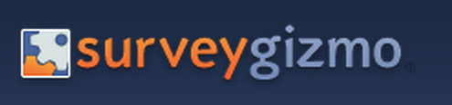
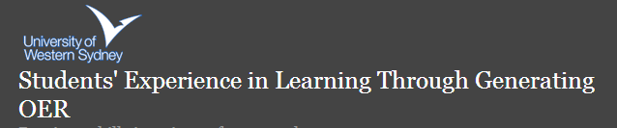

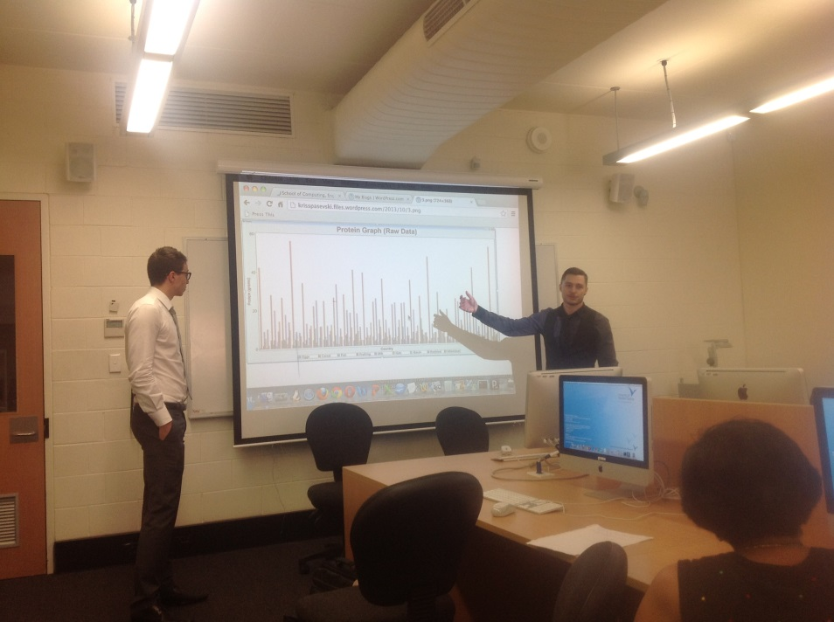
Assessment and
Learning Performance
Online survey
Quizzes
Students’ presentation
Data Mining Spring 2013

Slide 13
Mais M. Fatayer
University of Western Sydney
m.fatayer@uws.edu.au

