Slide 1
ASCILITE Conference, Sydney, 2013
Making the most of MOOCs:
An International Distance Learning perspective
Valeri “Val” Chukhlomin, PhD
Associate Professor
State University of New York Empire State College
Center for Distance Learning
valeri.chukhlomin at esc.edu
Notes:
ASCILITE Conference, Sydney, Australia, December 2013
Making the most of MOOCs: An International Distance Learning perspective
Associate Professor Valeri “Val” Chukhlomin, SUNY Empire State College, Saratoga Springs, New York

Slide 2
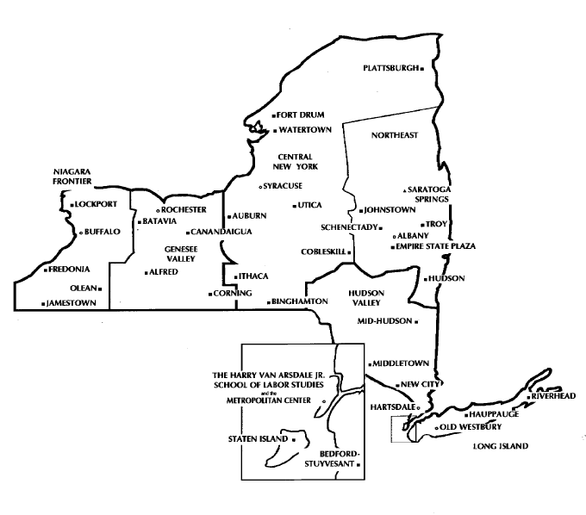
ASCILITE, 2013
Institutional Context: Empire State College
A SUNY solution for working professionals
Over 18,000 students
Undergraduate and graduate, incl. MBA
34 locations around New York State
Modalities: fully online, local study groups, independent studies
Offshore international programs.
Canada
Pennsylvania
New York City
2
Notes:
Institutional Context: SUNY Empire State College
A SUNY solution for working professionals
Over 18,000 students
Undergraduate and graduate, incl. MBA
34 locations around New York State, as well as online learning
Modalities: fully online, local study groups, residencies, totally independent studies
Offshore international programs.

Slide 3
ASCILITE, 2013
Institutional Context: Center for Distance Learning
8,000 undergraduate students; 50 full time and 500 part time instructors; small classes (up to 20)
Working adults (av. 34 years), individualized degree programs, mentoring approach, PLA
Asynchronous, writing intensive studies
SLN, “ANGEL”, now Moodlerooms + Mahara
OPEN SUNY (launching January 2014)
Located in Saratoga Springs, NY
3
Notes:
Institutional Context: Center for Distance Learning
8,000 undergraduate students; 50 full time and 500 part time instructors; small classes (up to 20)
Working adults (average age 34 years), individualized degree programs, mentoring approach, PLA
Asynchronous, writing intensive studies
Pedagogy informed by progressive learning theories
SLN, “ANGEL”, now Moodlerooms + Mahara
OPEN SUNY (launching January 2014)
Located in Saratoga Springs, NY

Slide 4
ASCILITE, 2013
Problem Identification: IDL
International Distance Learning (since early 1990s)
Support for resident offshore programs (Cyprus, Greece)
Non-matriculated international students (50 countries)
A series of double degree, IDL projects in Russia
Omsk State University (1998-2003), Tomsk State University of Radioelectronics (2007 – now), Moscow’s Presidential Academy (2012 – now)
A low retention rate (1 in 5); looking for solutions
4
Notes:
Problem Identification: IDL
International Distance Learning (since early 1990s)
Support for resident offshore programs (Cyprus, Greece)
Non-matriculated international students (50 countries)
A series of double degree, IDL projects in Russia
Omsk State University (1998-2003), Tomsk State University of Radioelectronics (2007 – now), Moscow’s Presidential Academy (2012 – now)
A very low retention rate (1 in 5); looking for solutions.

Slide 5
ASCILITE, 2013
Problem Identification: Barriers to IDL
Organizational (distance, textbook delivery, costs)
Technology and computer-mediated learning
Language, academic systems, culture, contexts
Classroom structure, expected behaviors
Academic writing, communications skills
Prerequisite subject matter knowledge and skills
ESC-specific requirements (degree planning)
Self-regulation and motivation.
5
Notes:
Problem Identification: Barriers to IDL
Organizational (distance, textbook delivery, costs)
Technology and computer-mediated learning
Language, academic systems, culture, contexts
Classroom structure, expected behaviors
Academic writing, communications skills
Prerequisite subject matter knowledge and skills
ESC-specific requirements (degree planning)
Self-regulation and motivation.
Based on:
Chukhlomin, V (2010a) “A Laboratory of Culture Shock” in All about Mentoring
Chukhlomin, V (2010b) “Delivering a SUNY Degree in Siberia: What Works, What Doesn’t” in The Laboratory on Borderless Higher Education

Slide 6
ASCILITE, 2013
Looking for solutions: IeLS
The Three B Framework: Bridging, Bilingual, Blended
International eLearning Skills (an online study, since 2007)
Developed for IDL projects with Russian universities
Emphasis on transition from teacher-centered to student-centered, self-regulated learning
Bilingual approach (with blended and video components)
Limitations:
Limited to course participants (registration, tuition fees, access)
A group study (requires an active project with a partner university)
Bilingual (vs. English only vs. multilingual).
6
Notes:
Looking for solutions: IeLS
The Three B Framework: Bridging, Bilingual, Blended
Based on: Chukhlomin, V., Deshpande, A. 2011, AACE Conference, Melbourne
International eLearning Skills (an online study, since 2007)
Developed for IDL projects with Russian universities
Emphasis on transition from teacher-centered to student-centered, self-regulated learning
Bilingual approach (with blended and video components)
Limitations:
Limited to course participants (registration, tuition fees, access)
A group study (requires an active project with a partner university)
Bilingual (vs. English only vs. multilingual).

Slide 7
ASCILITE, 2013
Looking for solutions: SDL in USSVE
A massive, open, online course for IDL (iMOOC)
For all partner universities abroad - free
For anyone interested in obtaining skills to navigate MOOCs in the US
Introduction to Self-Directed Learning in US-Style Virtual Environments (to be launched on March 24, 2014)
Mirrors IeLS, students can transfer to IeLS to get college credit (fee based)
English; bilingual groups welcome (several languages)
Limitations:
Closer to traditional MOOCs (one-to-all pedagogy, not good for SDL)
A live lab is required for students to practice SDL.
7
Notes:
Looking for solutions: SDL in USSVE
A massive, open, online course (MOOC)
For all partner universities abroad - free
To include students from all 8 international programs of the College
For anyone interested in obtaining skills to navigate MOOCs in the US
Introduction to Self-Directed Learning in US-Style Virtual Environments (to be launched on March 24, 2014)
Mirrors IeLS, students can transfer to IeLS to get college credit (fee based)
English only; bilingual groups welcome
Limitations:
Closer to traditional MOOCs (one-to-all pedagogy, not good for SDL)
A live lab is required for students to practice SDL.

Slide 8
ASCILITE, 2013
Looking for Solutions: a Connectivist MOOC?
Connectivist educational philosophy
Inspired by George Siemens and Stephen Downes (CCK08)
3 MOOCs launched at CDL in 2012-13
VizMath (Yeager & Hurley-Dasgupta)
CMC11 Creativity and Multicultural Communication (Yeager & Hurley-Dasgupta)
Metaliteracy (Mackey, Jacobson & Yeager)
8
Notes:
Looking for Solutions: a Connectivist MOOC!
Connectivist educational philosophy
Inspired by George Siemens and Stephen Downes (CCK08)
3 MOOCs launched at CDL in 2012-13
VizMath (Yeager & Hurley-Dasgupta)
CMC11 Creativity and Multicultural Communication (Y & H-D)
Metaliteracy (Mackey, Jacobson & Yeager)
Based on: Yeager, C., Hurley-Dasgupta, B. & Bliss, C.A (2013). CMOOCs and Global Learning: An Authentic Alternative. Journal of Asynchronous Learning Networks, 17(2), 133-147
Slides 9-11 are retrieved from a presentation by CDL Dean Thomas Mackey, also available at: http://www.slideshare.net/tmackey/upcea-27100007?utm_source=slideshow03&utm_medium=ssemail&utm_campaign=share_slideshow

Slide 9
“The starting point of connectivism is the individual. Personal knowledge is comprised of a network, which feeds into organizations and institutions, which in turn feed back into the network, and then continue to provide learning to individual. This cycle of knowledge development (personal to network to organization) allows learners to remain current in their field through the connections they have formed.”
George Siemens
Connectivism:
A Learning Theory for the Digital Age
http://www.elearnspace.org/Articles/connectivism.htm
9
Notes:
George Siemens
Connectivism:
A Learning Theory for the Digital Age
http://www.elearnspace.org/Articles/connectivism.htm
“The starting point of connectivism is the individual. Personal knowledge is comprised of a network, which feeds into organizations and institutions, which in turn feed back into the network, and then continue to provide learning to individual. This cycle of knowledge development (personal to network to organization) allows learners to remain current in their field through the connections they have formed.”

Slide 10
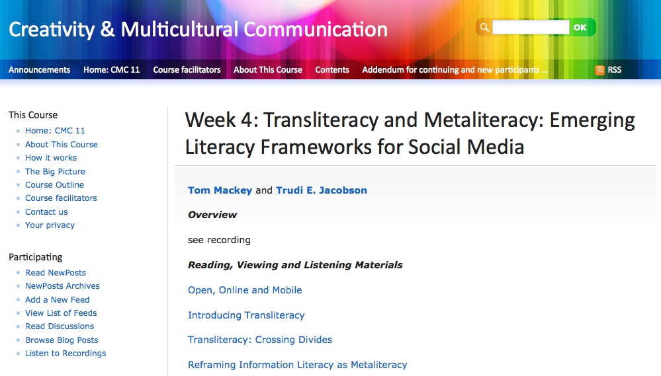
The First MOOC in the SUNY System
Dr. Betty Hurley Dasgupta and Carol Yeager
Notes:
The First MOOC in the SUNY System
Dr. Betty Hurley Dasgupta and Carol Yeager
Creativity and Multicultural Communication

Slide 11
Creativity and Multicultural Communication (CMC11)
Dr. Betty Hurley Dasgupta and Carol Yeager
559 registered participants
14 Registered for credit
13 undergraduates and 1 grad student completed
119 registered participant blogs
996 blog posts.
136 tweets
36 discussions
Facebook group started by participants still active
11
Notes:
Creativity and Multicultural Communication (CMC11)
559 registered participants
14 Registered for credit
13 undergraduates and 1 grad student completed
119 registered participant blogs
996 blog posts.
136 tweets
36 discussions
Facebook group started by participants still active
Thanks to Carol Yeager for all MOOC data

Slide 12
ASCILITE, 2013
The proposed alignment of MOOCs
CMC11
IeLS
SDL in USSVE
International eLearning Skills
For credit, educational planning course for enrolled IDL students, in Moodlerooms
Creativity and Multicultural Communication (Lab)
Both free and for credit, a connectivist MOOC for SUNY ESC students and for anyone, ongoing (no LMS)
Introduction to Self-Directed Learning in US-Style Virtual Environments
Free, a 8 week ,traditional MOOC, with multilingual components, for anyone, in Canvas
Valeri.Chukhlomin at esc.edu Slide 12
Notes:
The proposed alignment of MOOCs
International eLearning Skills
For credit, educational planning course for enrolled IDL students, in Moodlerooms
Introduction to Self-Directed Learning in US-Style Virtual Environments
Free, a 8 week ,traditional MOOC, with multilingual components, for anyone, in Canvas
Creativity and Multicultural Communication (Lab)
Both free and for credit, a connectivist MOOC for SUNY ESC students and for anyone, ongoing (no LMS)

Slide 13
ASCILITE, 2013
Highlights
The main point of entry for students: SDL in USSVE
Work with partners to get students interested in developing competencies and skills to benefit from US-style MOOCs
Attract students interested in mastering US-style, computer-mediated communications
As a scaffolding tool, create bilingual communities of practice led by foreign-born faculties and student peers
Based on OER, delivered via Canvas Network
Get knowledge, build skills, then use CMC11 as a lab
Use IeLS to get college level credits in US.
13
Notes:
Highlights
The main point of entry for students: SDL in USSVE
Work with partners to get students interested in developing competencies and skills to benefit from US-style MOOCs
Attract students interested in mastering US-style, computer-mediated communications and tools used by American and international companies
As a scaffolding tool, create bilingual communities of practice led by foreign-born faculties and student peers
Based on OER, delivered via Canvas Network
Get knowledge, build skills, then use CMC11 as a lab
Use IeLS to get college level credits in US
Research based.

Slide 14
ASCILITE, 2013
Next steps
CMC11 is already operational and ongoing
IeLS is being redesigned for March 2014
SDL in USSVE is scheduled for March 2014
Bilingual groups: Hindi, Mandarin, Russian, Spanish
For programs abroad joined by partner universities
Survey instrument
Possible partnership with OPEN SUNY.
Collaborators are welcome!
14
Notes:
Next steps
CMC11 is operational and ongoing
IeLS is being redesigned for March 2014
SDL in USSVE is launching in March 2014
Bilingual groups: Hindi, Mandarin, Russian, Spanish
8 programs abroad to join PLUS partner universities
Survey instrument
Possible partnership with OPEN SUNY
Collaborators are welcome!

