Slide 1
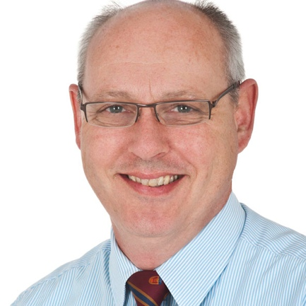
Student experience and expectations of technology
Associate Professor Michael Sankey
Director, Learning Environments and Media

Slide 2
Why this research?
The evolving opportunities technological change provides requires the frequent evolution of services and curriculum to facilitate engaged learning.
The resources and costs involved need to be carefully weighed up against the potential benefits of the affordances.
Important to have an evidence-based approach to inform strategy and planning.
Understanding how and what students’ use and what their expectations of technologies for both life and study is clearly essential.
The technologies explored here included, institutional systems (email, LMS), Web2.0 technologies (social networking, cloud & shared spaces) and personal devices.
This presentation provides some initial findings and reflects on some implications for emerging learning environments and meeting expectations for ‘todays’ student.

Slide 3
The tool and method
Methodology: Mixed Methods
Students’ Experiences and Expectations of Technology Survey (SEETS)
It contained 127 questions, coving student’s access and use of technologies
Plus four open-ended response questions
Online focus groups (n=34) using Blackboard Collaborate
Five main sections
Technologies currently used in everyday life for social and work purposes.
Current & preferred use of technologies for learning and communicating with the wider university.
The services and support provided for learning.
The technologies used to interact with the university for administrative purposes.
General demographic information
Notes:
This survey was originally developed and deployed in 2010 by Macquarie University, the University of Technology Sydney and the University of Western Sydney by Gosper, Malfroy, McKenzie & Rankine (2011). SEETS was generated by drawing on the ECAR Survey (EDUCAUSE, 2008), and the Great Expectations of IT Survey developed by the Joint Information Systems Consortium (JISC, 2008).

Slide 4
Base demographics
N = 1181
68% external/distance
56% Part-time
65% Female
73% Mature age
67% Undergraduate
40% In their first year
40% work Full-time
29% No paid employment
68%
28%
73%

Slide 5
The computing equipment they have access to
90%
67%

Slide 6
Primary Internet access
60%
1%

Slide 7
Top 10 tools used outside study
96%
77%
35%

Slide 8
Some interesting shifts
82%

Slide 9
Technologies for learning
70%
16%
14%

Slide 10
Develop an ePortfolio as a record of learning and experiences for professional or employment purposes
While 8.7% reported current regular use of ePortfolio for professional or employment purposes, 37.1% reported wanting to use this more often.
541 students (57%) who had selected ‘never to rarely’ moved their preference to wanting some level of engagement with this technology.

Slide 11
Use web conferencing or video chat (eg Skype, Wimba, FaceTime) to join in remotely to lectures or tutorials
80% (944) of students have not used web conferencing to join in with lectures or tutorials in the past
65% (618) of these respondents said that they would like to in the future.
This has significant implications as to how USQ may look to engage with this type of technology in the future

Slide 12
Use web-based document tools (eg Google docs) to work collaboratively on activities and assignments
17.8% of students reported current regular use of web-based document tools,
47.3% reported wanting to use these more often.
504 students (43%) moved their preference from ‘never to rarely’ to wanting some level of engagement with this technology

Slide 13
Student with staff Student with student

Slide 14
Technologies for Admin Purposes
67%
Twitter
RSS feeds
Email
Paper-based letters or memos

Slide 15
Technologies for Admin Purposes
Facebook
Mobile voice calls
50/50
Mobile apps
Communications through LMS

Slide 16
Take home messages from FGs
They are starting to use iPads more but mainly still use laptops.
Recorded lectures provide flexibility and mobility, eg. able to play on iPod and listen while travelling etc. Able to repeat sections. Hearing/seeing lecturer gives better ‘feel’ for information than reading on printed page. Other students ask questions during lecture, which can give additional information. Feel more connected to group.
Respondents saw the USQStudyDesk as adequate in contributing to their feeling part of a ‘community of learners’ and were opposed to using Facebook which they see as for personal use only.
‘Consistency’ was a main theme that has emerged both from this survey and Focus Groups. Consistency in the ‘look and feel’ of study desk, the quality of resources available, the staff interaction online. But not sameness.
Strong preference for us to provide online training for technologies.

